Slide 1
GROUP-7 DATABASE SERVER
Suvithra Murugan
Narayana Varsha
Durga Bhavani Asadi
Ramya Bejawada

Slide 2
Introduction
A database server is a machine running database software dedicated to providing database services.
It is a crucial component in the client-server computing environment where it provides business-critical information requested by the client systems.
A database server consists of hardware and software that run a database.

Slide 3
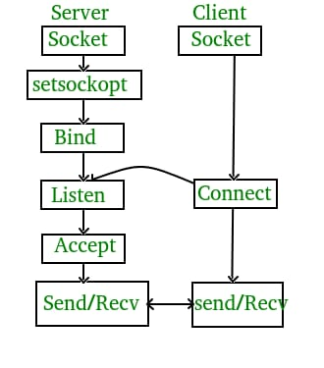
Client-Server Communication

Slide 4
What is Database Server?
A database server is a machine running database software dedicated to providing database services. It is a crucial component in the client-server computing environment where it provides business-critical information requested by the client systems.
A database server consists of hardware and software that run a database.

Slide 5
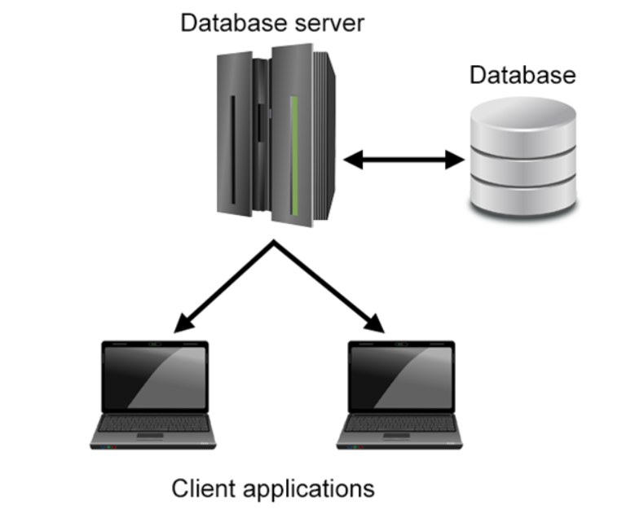

Slide 6
Why Database is used?
A database is a collection of data, usually stored in electronic form. A database is typically designed so that it is easy to store and access information.
A good database is crucial to any company or organization. This is because the database stores all the pertinent details about the company such as employee records, transactional records, salary details etc.

Slide 7
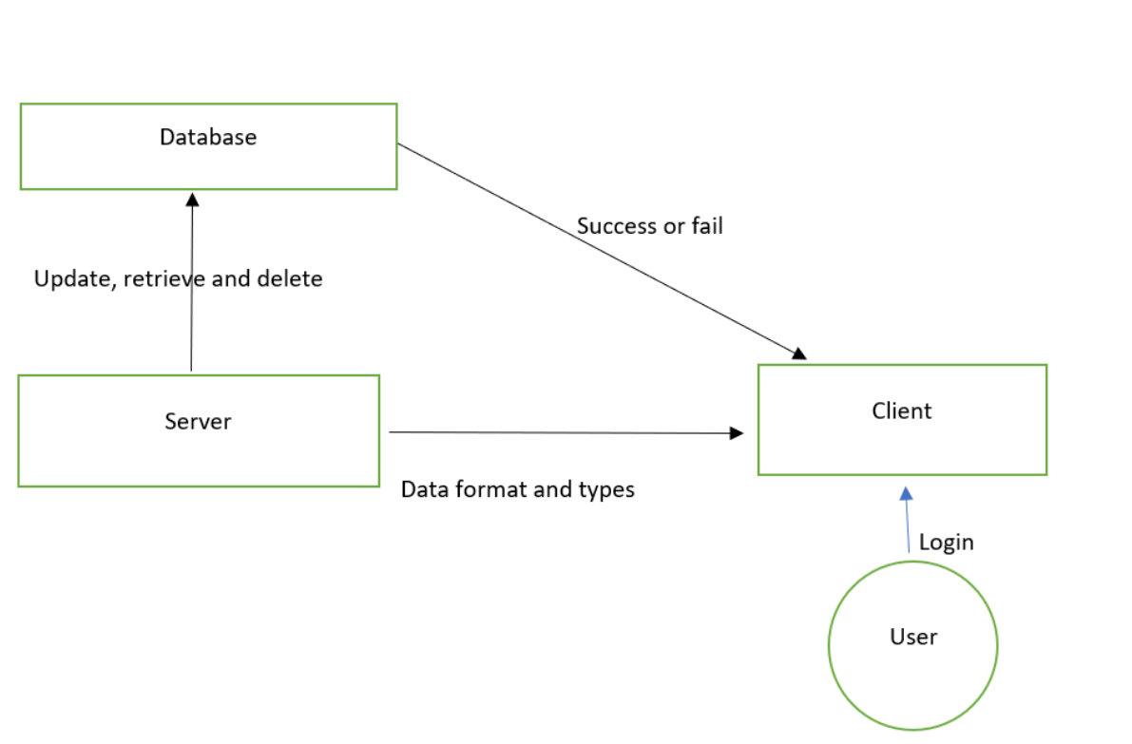
Dataflow

Slide 8
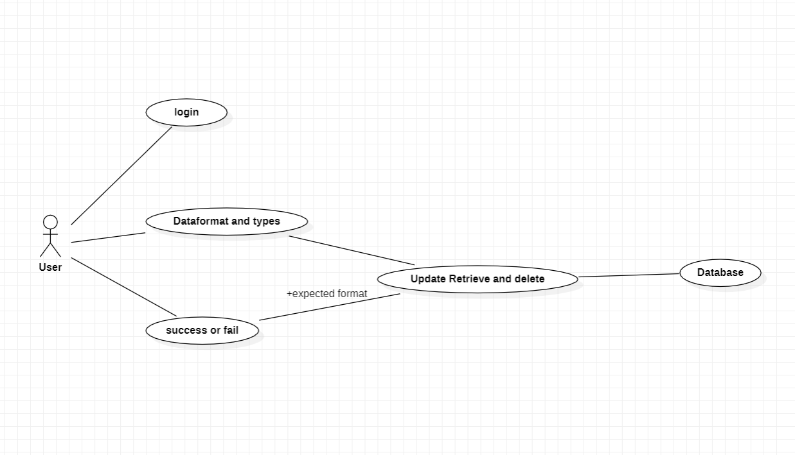
Usecase diagram

Slide 9
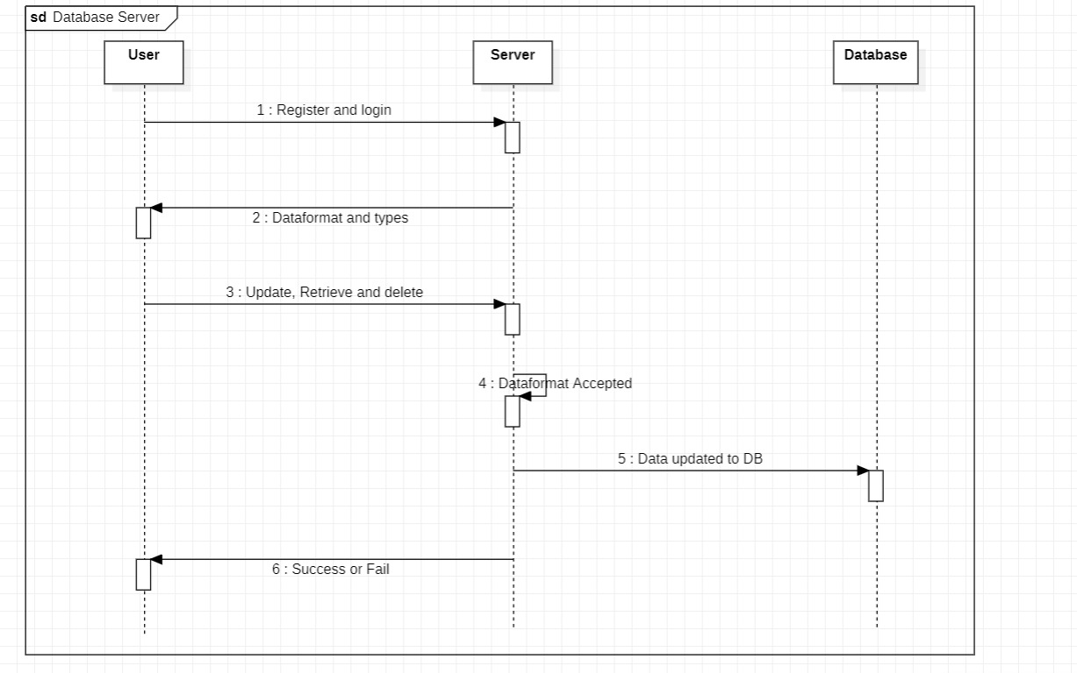
Sequence diagram

Slide 10
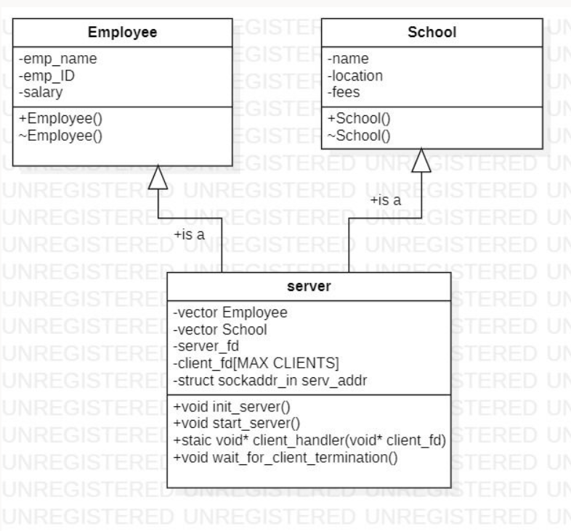
Class diagram

Slide 11
Multi-Directories
SRC
INCLUDE
TOOLS
BIN
OBJ

Slide 12
Tools
CPPCheck
CPPUnit
Valgrind

Slide 13
Advantages
Integrity of data
Security of data
Minimum data redundancy.
Improved data security.
Increased consistency.
Lower updating errors.
Reduced costs of data entry, data storage, and data retrieval.
Improved data access using host and query languages.
Higher data integrity from application programs.

Slide 14
Conclusion
Database servers are used to store and manage databases that are stored on the server and to provide data access for authorized users.
Here, we have performed operations like updation, retrieving and deletion of data from the database as per client request.

Slide 15
THANK YOU..
GROUP-7

